Slide 1
Capable Environments
2025

Slide 2
Word Cloud on menti meter
What words come to mind when you hear ‘Capable Environment’?

Slide 3
Capable environment (evidence base)
A group of researchers (Peter McGill, Jill Bradshaw, Genevieve Smyth, Maria Hurman & Ashok Roy) looked into what elements need to be in place to maintain effective support within the community where people’s needs are all met.
There are 12 elements, all of which need to be in place.
Download the capable environments paper here:
McGill-et-al-Capable-environments.pdf

Slide 4
research and service evaluations outcomes:
Quality of life enhancement,
Quality of support
Reduction or prevention of behaviours of concern
Carer satisfaction
(McGill, 1993)
(Allen et al., 2013)
(Croucher, 2022)
Notes:
Important to recognise evidence base – McGill first proposed ideas in 93 – 30 years of evidence to support research showing CE work – our study is adding to this data set and we are also looking at our pilots inter-reliability and validity as done in all evidence based research projects.

Slide 5
This infographic can be downloaded here:
Capable_environments_diagram_SCREEN

Slide 6
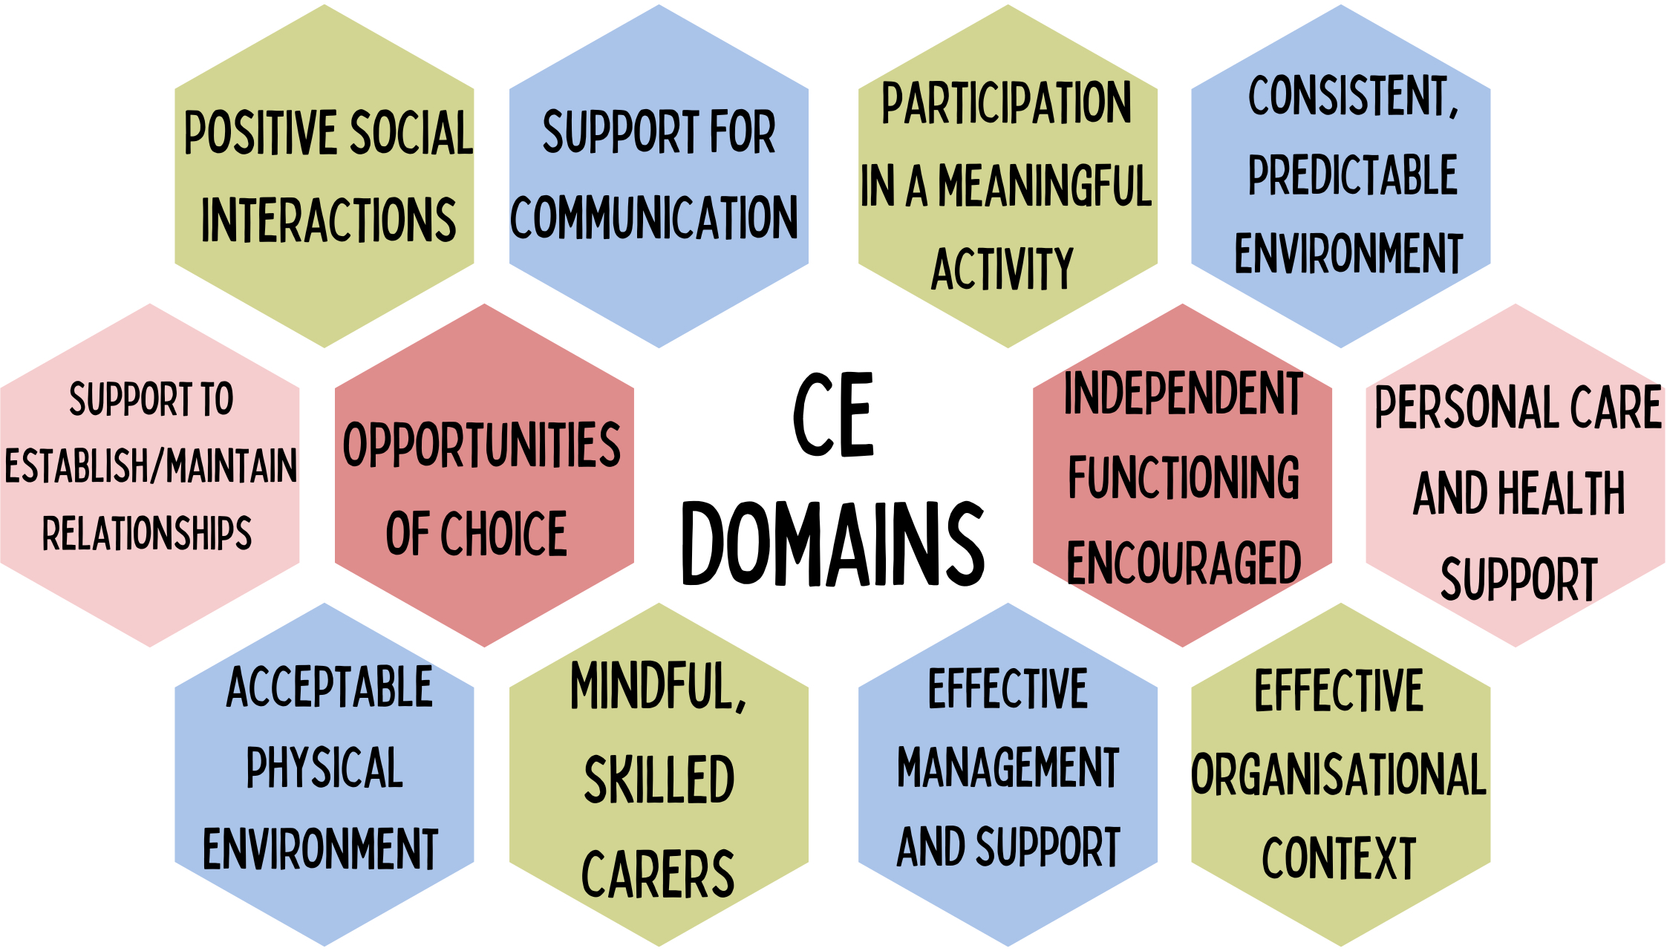

Slide 7
How do we implement a CE approach? And why is it different to ‘business as usual’?

Slide 8



Preventative work
collaborative
Setting-wide
Reduces triggers for distressed behaviour
Encourages skills development.
Enhances predictability and structure
Increases success and engagement
Enhances wellbeing and mental health
Promotes independence and competence.
A capable environment approach is collaborative because it requires multiple stakeholders—such as individuals, families, educators, employers, healthcare professionals, and community members—to work together.
Shared responsibility & decision making.
Cross disciplinary working.
Moves the focus away from working with an individual instead considers the capacity of the setting as a whole for all residents
Uses a mix of direct staff support and systems change:
First stage of intervention focuses on management and practice leadership before second stage enables staff to co-produce growth in other CE domains

Slide 9
How a Capable Environment Aligns with Practice Leadership
Capable Environment Element | Practice Leadership Principle | Impact in Practice
Proactive Support | Leaders anticipate needs and remove barriers before issues arise | Prevents crisis management and supports long-term success
Collaboration & Inclusion | Leaders involve teams, families, and stakeholders in decision-making | Encourages shared ownership and sustainable change
Clear Expectations & Structure | Leaders provide clarity in roles, responsibilities, and goals | Reduces confusion, increases engagement and accountability
Flexibility & Adaptability | Leaders respond to feedback and adjust support accordingly | Supports continuous improvement and innovation
Skill Development & Empowerment | Leaders coach and mentor others to build independence | Fosters growth, confidence, and capability in individuals and teams

Slide 10
Menti Meter
What challenges do you face in creating a capable environment?
What solutions have helped overcome barriers to a capable environment?

Slide 11
Provider feedback from pilot 1&2
Providers liked the Capable Environments (CEs)approach. They particularly liked being involved in the observation, stating it enabled them to be ‘more reflective and think holistically about the environments within their services’.
Having all the CLDT conduct the initial pilot meetings together made the providers feel that everybody was aware of their actions and the timeframes.
Providers highlighted their positive experiences of the preventative approach the pilot offered. Expressing how they were keen to utilise the approach to avoid future “crisis”, where they might usually receive support from the CLDT.
Providers liked the collaborative nature of the CE approach; they valued having members of each discipline supporting and considered it ‘more efficient’.

Slide 12
Being involved in the capable environment project motivated the team to be more engaged, to play a part in the delivery of non-linear, person-centred care as opposed to merely performing it. If you think about that for a moment, the difference is truly life changing.
“
”
IOTA Manager Mark Peard

Slide 13
The importance of capable environments
These environments support people to thrive not survive
Needs are met, positive social interactions occur and there is opportunities to do things that are important to people supported
People can enjoy a good quality of life
Behaviours of concern are less likely to occur within capable environments
Overly restrictive environments are generally incompatible with capable environments
The more restrictive an environment is the more likely people are to be distressed and unhappy
They are more likely to respond to restrictions with behaviours of concern which may include withdrawal
Capable environments are the opposite to institutionalised environments

Slide 14
Feedback and Questions.

